Slide 1
2-3 TREES
DATA STRUCTURES CS 201

Slide 2
TEAM MEMBERS
Fareeha Sattar Shaikh (16k-3934)
Taban Shaukat (16k-3937)
Huzaifah Punjani (16k-3924)

Slide 3
CONTENT TO BE DISCUSSED:
Introduction
Motivation
Analysis of Time Complexity
Comparison analysis with different data structures
Applications
Conclusion

Slide 4
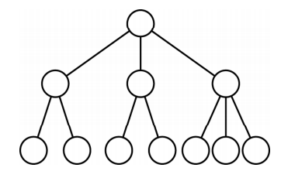
INTRODUCTION
A type of multi way data structure
All leaf nodes must be at same level
It contains two types of nodes:
2 Node, which contain one data element and have two children
3 Node, which contain two data element and have three children

Slide 5
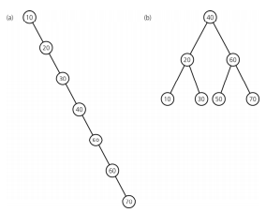
Why care about advanced implementations?

Slide 6
MOTIVATION
To shed light on a type of balanced search trees
To understand the special type of multi way trees
To know a specialized type of B trees, of maximum order 3

Slide 7
INSERTION
ALGORITHM
If the tree is empty, create a node and insert the value.
Otherwise find the leaf node where the value belongs.
If the leaf node has only one value, put the new value into the node
If the leaf node has more than two values, split the node and promote the median of the three values to parent recursively.

Slide 8
SEARCHING & TRAVERSALS
Algorithm:
If N is a Root Node and its Null return
Case 1: If N is leaf node match value if matched return
Case 2:If N is a 2 Node
if value <current value repeat search function with root.left
Else repeat search function with root.right
Case 3: If N is 3 Node
If value <current repeat search function with root.left
If value>current repeat search function with root.right
Else repeat search function with root.middle

Slide 9
DELETION
ALGORITHM
Find Parent node(P) of the node that needs to be deleted.
Case 1: P has 3 children
Case 2: P has 2 children only
P is ROOT of the tree
P has LEFT OR RIGHT SIBLING with 3 children
P’s SIBLING(s) has 2 children only

Slide 10
ANALYSIS OF TIME COMPLEXITY
Here, the time complexity is calculated for all the operations performed in 2-3 tree by taking n=8 and by applying formula of log(n) for all operations.

Slide 11
COMPARISION ANALYSIS WITH DIFFERENT DATA STRUCTURES:

Slide 12
APPLICATIONS:
Small organizations which uses small data structures.
Systems that requires lower update cost on average as compared to BST.
For example:
For storing the Billing IDs with their respective Customer Names in a Departmental Store.

Slide 13
CONCLUSION :
It can be used for special purposes.
It provides a good insight in the field of multi way trees.
Lesser practical applications

